Slide 1
CycleSIGHT
Because pain isn’t one-size-fits-all.
Preliminary Pitch
Q1
February
2026
Aiyana Sharpe, Farruh Turgunov, Gloria Jackson
Notes:
There is a silent crisis affecting millions of people seeking relief from chronic menstrual pain. They are told to take ibuprofen or naproxen. But for a significant portion of this population, these common NSAIDs are not just ineffective—they are a silent killer in the making.

Slide 2
Kidney disease is the 8th leading cause of death in the US, followed by liver disease.
*The CDC, 2023
PROBLEM
https://www.cdc.gov/nchs/fastats/leading-causes-of-death.htm
Notes:
While often attributed to other factors, a major, hidden contributor to chronic organ injury is the unmonitored, long-term, high-dosage use of NSAIDs to manage debilitating pelvic pain.

Slide 3
The Solution: CycleSIGHT
Because pain isn’t one-size-fits-all.
CycleSIGHT transforms chronic pelvic pain management into safe, targeted precision medicine for just $200.
By analyzing genetic markers for drug metabolism, pain sensitivity, and endometriosis risk, we empower clinicians to select the right treatment immediately—protecting patient organ health while drastically reducing the costs of delayed diagnosis.
Notes:
To stop this cycle of damage, we created CycleSIGHT. We aren't just selling a test; we are offering a personalized treatment roadmap for $200. By analyzing specific genetic markers related to drug metabolism, pain sensitivity, and endometriosis risk, we empower clinicians to stop guessing and start treating. Why is this important? Because pain isn’t one-size-fits-all — but treatment often is. When underlying pain biology isn’t considered, patients may depend on repeated NSAID use, increasing their risk of kidney and liver disease. We provide a precision pain profile that helps prevent that avoidable harm.

Slide 4
Genetic Variants of Interest
Drug Metabolism
Pain Sensitivity
Endometriosis Risk
SNPs rs1799853 & rs1057910 in the CYP2C9 gene on chromosome 10
Associated Effect: Decreased/Nonexistent NSAID metabolism
SNP rs4680 in the COMT gene on chromosome 22→Increased pain perception
SNP rs20417 in the PTGS2 (COX-2) gene on chromosome 1→Decreased NSAID efficacy
SNP rs17562 in the ILA1 gene on chromosome 2
SNP rs7521902 in the WNT4 gene on chromosome 1
Associated Effect: Increased endometriosis susceptibility

Slide 5
The CycleSIGHT Journey
Patient Consultation
Test Ordered
Collect Sample
Molecular Analysis
Personalized Care
Patient presents at PCP or health clinic with symptoms such as:
-Severe dysmenorrhea
-Suspected endometriosis
-Issues with standard NSAID/hormonal therapy
Clinician orders CycleSIGHT test.
The kit is shipped to the patient’s home.
Patient provides a saliva sample via a painless buccal swab and mails it back to the lab.
The patient's saliva sample is analyzed at our CLIA-certified lab using qPCR TaqMan assay technology to identify targeted SNP genotypes for 6 key markers in the CYP2C9, COMT, PTGS2, IL1A, and WNT4 genes
A report is generated and sent to the clinician.
The clinician uses the report to guide treatment such as switching from NSAIDs to alternative analgesic methods, adjusting NSAID dosage, and/or expediting specialized imaging for endometriosis.

Slide 6
Genetic Profile (SNP) | Finding | Possible Clinical Interpretation from CycleSIGHT Report
CYP2C9 (rs1799853/rs1057910) | *2 or *3 Allele | "NSAID Metabolism Issue." Patient is a slow/poor metabolizer. High risk of toxicity with standard NSAID doses.
COMT (rs4680) | Met/Met Genotype | "High Pain Sensitivity." Patient requires stronger pain management interventions; low tolerance for discomfort.
PTGS2 (rs20417) | C/C Genotype | "Low NSAID Efficacy." Patient naturally produces fewer prostaglandins via COX-2. NSAIDs are unlikely to provide significant relief.
IL1A/WNT4 (rs17561/rs7521902) | Risk Variants Present | "High Endometriosis Risk." Strongly supports early diagnostic imaging (MRI/Ultrasound) to reduce diagnostic delay.

Slide 7



Meet the team
Farruh Turgunov
Gloria Jackson
CFO
CEO
Directs financial strategy, market analysis, and venture positioning to ensure long-term sustainability
Drives the development of personalized diagnostic tools by bridging clinical workflow insights with advanced genomic research
Aiyana Sharpe
CTO
Bridges genomic rigor with clinical workflow, leading technical development and assay design for a scalable, provider-friendly platform
Notes:
Why is our team special? We are passionate individuals combining clinical and bioinformatic expertise.

Slide 8
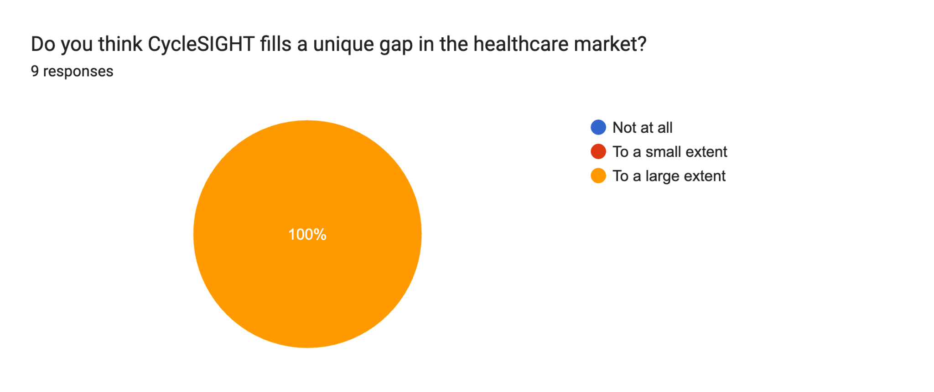
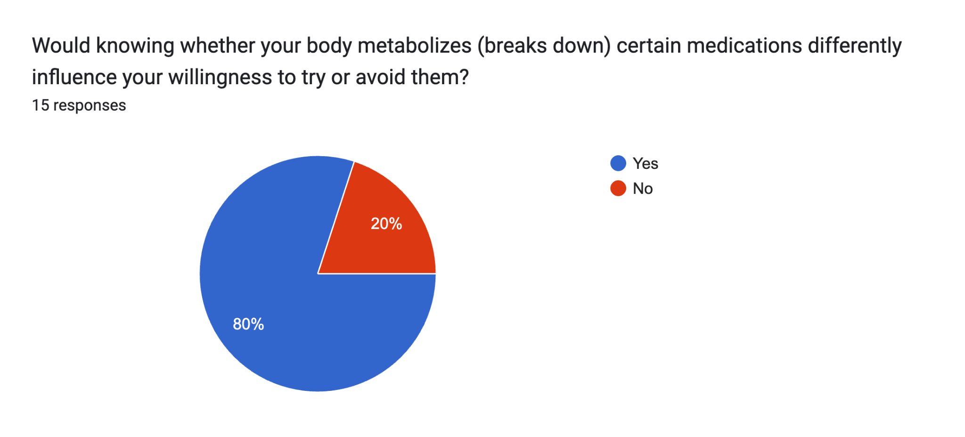
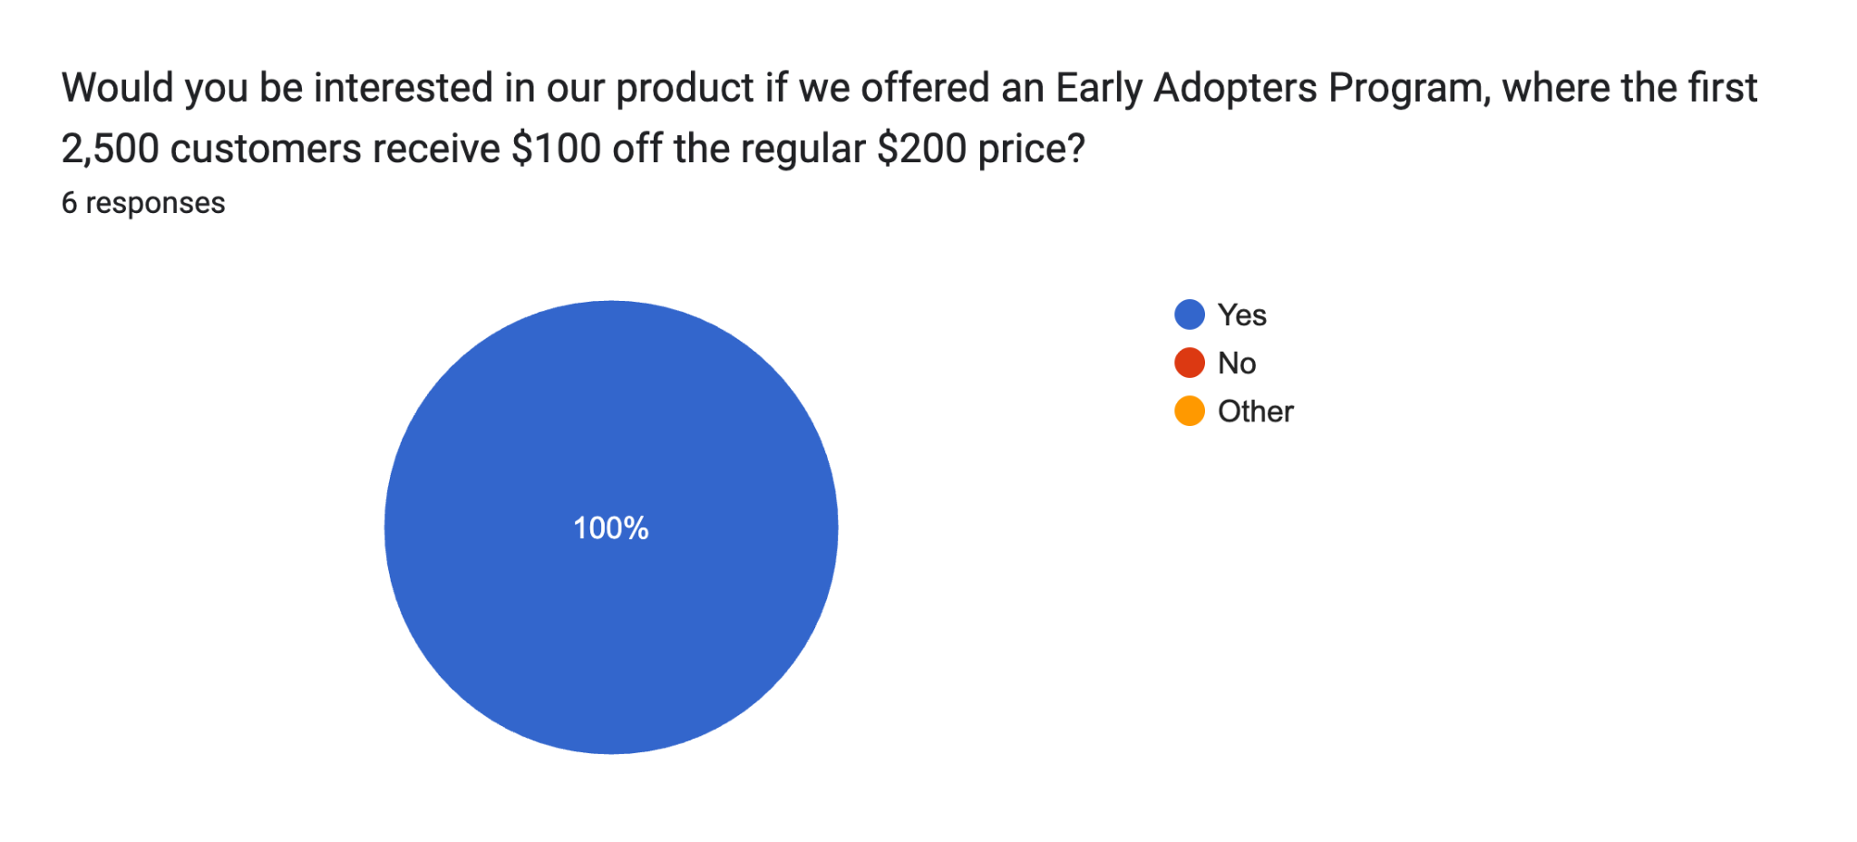
Some Customer Discovery Stats So Far…

Slide 9
Customer Discovery Plan: Who will pay for this and why?
Understand what is required for a new CPT(Current Procedural Terminology) code
Gauge the willingness to pay for uninsured individuals
1. Data Collection
To Gain Early Traction/ Support:
Early Adoption Program
Offer $100 cash-pay price for first 2500 patients.
Insurance/ Payers
Provider
Interviews
Patient Focus Groups
Self-Pay Buffers
Campaign
5. Revenue and Implementation Strategy
Pilot Facility Contracts
Insurance Companies
2. Identify Primary Customer
Gain Early Traction
Ask customers why would they use our service over other competitors?
CycleSIGHT offers specialized integration(genetic markers combined with clinical symptoms)
qPCR : high precision/ low cost for only 6 SNPs
Myriad Genetics
ICD-10 Code Analysis
What specific evidence is needed to move our test from “investigational” top “”Covered”
Does our service ultimately help attract more contacts with large employers?
23andMe
4. Evidence/ Stats from Customer Data
3. Competitive Advantage
Confidential
Notes:
Overall approach:
Prove that there is a clinical AND economic utility for our service
Would physicians pivot their treatment plans/ thinking based on our reports?
Will insurance reimburse for this test?
Primary customer / insurance company section
Interview medical policy directors
How much is the insurer currently spending on claims related to NSAID induced atrophy chronic kidney disease in women aged 18-45?
ICD-10-CM codes refer to diagnosis or issue that the treatment aims to support or resolve.
Needed to establishing medical necessity: allows insurance companies to determine coverage
CPT codes: used to determine reimbursement for provider SERVICES/TREATMENT
Specialized integration: we provide more than just data, integrate our results by providing data on top of knowing the patient’s symptoms(context)
High precision : lower background noise compared to microarrays

Slide 10
Customer Discovery Plan: Who will pay for this and why?
Understand what is required for a new CPT(Current Procedural Terminology) code
Gauge the willingness to pay for uninsured individuals
1. Data Collection
To Gain Early Traction/ Support:
Early Adoption Program
Offer $100 cash-pay price for first 2500 patients.
Insurance/ Payers
Provider
Interviews
Patient Focus Groups
Self-Pay Buffers
Campaign
5. Revenue and Implementation Strategy
Pilot Facility Contracts
Insurance Companies
2. Identify Primary Customer
Gain Early Traction
Ask customers why would they use our service over other competitors?
CycleSIGHT offers specialized integration(genetic markers combined with clinical symptoms)
qPCR : high precision/ low cost for only 6 SNPs
Myriad Genetics
ICD-10 Code Analysis
What specific evidence is needed to move our test from “investigational” top “”Covered”
Does our service ultimately help attract more contacts with large employers?
23andMe
4. Evidence/ Stats from Customer Data
3. Competitive Advantage
Confidential
Notes:
EDIT THIS ONE

Slide 11
Customer Discovery takeaways
CycleSIGHT meets a unique need in this market
Insurance companies are our primary customer
CPT & ICD code analysis for medical insurance claim coverage
Incentive for first 2500 customers
Channel name
Channel name
Channel name

Slide 12
What were the estimates?
Total Addressable Market
TAM
TAM:
All Menstruating Individuals ~$570.4 Billion
SAM
Region Specific, a.k.a USA ~$21.39 Billion
SOM
Assuming we can service 375k women per year (0.25%): ~$75m per year.
SAM
Serviceable Available Market
SOM
Serviceable Obtainable Market

Slide 13
Timeline
January
February
March
April
May
June
July
Formalize Company Structure
In this stage, we will go through hiring processes as well as begin outreach attempts to get our company known and exposed to some clinicians and to the public
Finalization Steps
In this stage, we will finalize the workflow, rigorously hire new employees, and being pursuing a CLIA certification.
Refinement
In this stage, we will go through more outreach and launch an initial clinical pilot program in attempts to get our company known and exposed to some clinicians and to the public
WE’RE HERE
First 3 Months
The Next 4-8 Months
Next 6-12 Months
R&D Development
In this stage, we will go through the process of setting up our panel in the process, ensure that said process works and is reliably repeatable
1 Year from now
2 Years from now
Increase Scale
In this stage, we will have established everything we need to increase scale, look to establish new lab locations and even license out the process

Slide 14
Thank you!
CycleSIGHT
Because pain isn’t one-size-fits-all.

